Slide 1

Law about AI

Slide 2


LAW [GB]
AI Regulation and Institutional Change
Transforming State Authority in AI’s Global Shadow
Margarita Amaxopoulou
  Offers applied and original empirical insights into the transformation of the State, triggered by the rise of AI and the need to regulate it across borders
  Provides a holistic understanding of the actors, norms, and processes surrounding AI regulation as a contemporary global phenomenon
  Provides valuable lessons and recommendations that can inform AI policy development and implementation
11 December 2025
Hardback £90.00
ISBN: 9781509986385
288 pages

Slide 3

LAW [GB]
A Rights-Based Inter-Legal Approach to Artificial Intelligence
Sümeyye Elif Biber
  First book to offer a rights-based framework when addressing AI and human rights challenges
  Based on an innovative inter-legal approach
  Will offer a conceptual foundation for both scholars and policy-makers navigating this complex, fast moving field
30 October 2025
Hardback £85.00
ISBN: 9781509979011
304 pages

Slide 4

LAW [GB]
Future-Proof Legal Services
How Innovation, Legal Tech and AI Have Been Reshaping the Legal Market
Edited by Riccardo de Caria & Silvia Martinelli
  Provides a broad analysis of the legal market today
  Presents the reasons for the evolving legal market and a roadmap for the road ahead.
  Ideal for lawyer who need to assist clients with their compliance obligations related to new data driven business models, AI and sustainability accountability systems
02 October 2025
Hardback £110.00
ISBN: 9781509987009
432 pages

Slide 5

LAW [GB]
Law and Practical Reason
Moral Responsibility and Artificial Intelligence
Maximilian Kiener
  Addresses pressing challenges around moral responsibility and artificial intelligence
  Presents a novel conception of strict answerability, as opposed to strict liability, showing that taking responsibility is a genuine normative power
  Provides solutions to challenges around ‘responsibility gaps’ and trustworthy AI
02 October 2025
Hardback £90.00
ISBN: 9781509956845
224 pages

Slide 6

LAW [GB]
AI and the Rule of Law
The Necessary Evolution of a Concept
Paul Burgess
  The first book to focus on the rule of law and AI
  Provides a clear and ready way to identify and understand the concept of the Rule of Law in the changing legal landscape
  Considers the limitations that will need to exist in the future to harness AI
28 August 2025
Paperback £42.99
ISBN: 9781509963218
200 pages

Slide 7

LAW [GB]
Dark Patterns, Deceptive Design, and the Law
AI’s Hidden Influence on Our Digital Experience
Mark Leiser
  Provides a foundational understanding of dark patterns and deceptive design, their ethical significance, and the broad societal harms they cause
  Evaluates the effectiveness of current regulatory responses and proposes adaptations to improve their scope, including assessing AI-specific regulatory needs
  Offers a roadmap for actionable change, equipping readers with the knowledge and tools to recognise, resist, and advocate against manipulative digital practices
21 August 2025
Paperback £21.99
ISBN: 9781509987115
Hardback £65.00
ISBN: 9781509987108
368 pages

Slide 8

LAW [GB]
Copyright and Patent Laws for the Age of Artificial Intelligence
Authorship and Inventorship Revisited
Eva Janecková
  Looks at the intersection between IP and AI from a human-creator perspective
  Analyses the operation of the concepts of authorship and inventorship in the AI context
  Provides a comparative analysis and identifies weak points in the law of authorship and inventorship
26 June 2025
Hardback £90.00
ISBN: 9781509976232
304 pages

Slide 9

LAW [GB]
Hart Studies in European Criminal Law
AI Evidence and Criminal Proceedings
Edited by Katalin Ligeti
  Distinguished experts on the national law contribute individual chapters on the six examined countries
  Provides interdisciplinary and real-world analysis and proposed solutions
26 June 2025
Hardback £90.00
ISBN: 9781509976560
368 pages

Slide 10

LAW [GB]
Hart Studies in Information Law and Regulation
Big Data for the Public Good
Regulating Access to Public Sector Big Data for Research and Innovation
Stergios Aidinlis
  Unpacks the regulation of access to public sector big data for research and innovation purposes in the UK, drawing on empirical insights from real-world practitioners
  Structured deliberately in a manner that is appealing to stakeholders affected by data sharing regulations
  Covers key legal instruments such as the Freedom of Information Act 2000, the Data Protection Act 2018, the Digital Economy Act 2017, and the Human Rights Act 1998
12 June 2025
Hardback £90.00
ISBN: 9781509973309
272 pages

Slide 11
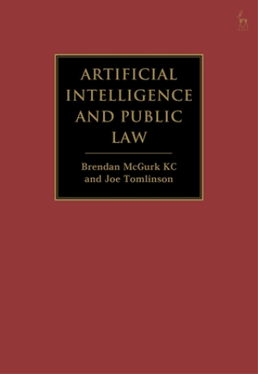
LAW [GB]
Artificial Intelligence and Public Law
Brendan McGurk KC & Joe Tomlinson
  The first comprehensive treatment of the application of public law to AI in the public sector
  Provides detailed analysis of novel legal questions in a quickly-evolving area of legal practice
  A valuable guide to the law for legal practitioners in private practice and public bodies, as well as legal researchers
12 June 2025
Hardback £140.00
ISBN: 9781509966707
320 pages

Slide 12

LAW [GB]
Computers, Privacy and Data Protection
Data Protection, Privacy and Artificial Intelligence, Volume 17
To Govern or To Be Governed, That Is the Question
Edited by Eleni Kosta, Dara Hallinan, Paul De Hert & Suzanne Nusselder
  Highlights issues related to the governance of artificial intelligence
  Looks at the regulatory changes introduced by the EU AI Act
  Examines the risks to fundamental rights associated with AI usage by law enforcement agencies
01 May 2025
Hardback £55.00
ISBN: 9781509984015
368 pages

Slide 13


BP LAW [GB]
AI on Trial
2nd Edition
Mark Deem & Peter Warren
  Three new “evidence chapters” on the digital divide, AI in education, and Gen AI and a completely reworked chapter on data ownership
  An innovative approach to the most innovative of technologies, it is structured in the style of a trial with AI itself being on trial, including Opening Submissions, Evidence, Closing Submissions and the Verdict
  Mark Deem is a leading UK legal practitioner on AI and Peter Warren is a leading technology and investigative journalist and includes interviews with leading technologists, regulators and thought-leaders from the UK, US and Europe making it truly as international in scope as the topic itself is
20 March 2025
Paperback £54.99
ISBN: 9781526531735
400 pages

Slide 14
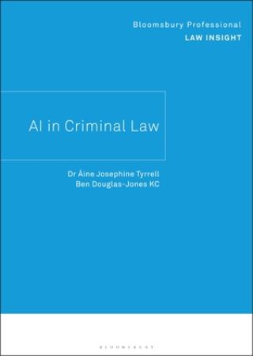
BP LAW [GB]
Bloomsbury Professional Law Insights
AI in Criminal Law
Áine Josephine Tyrell & Ben Douglas-Jones KC
  Written by an author with a unique perspective and experience of AI policy and regulation
  Clear exposition of AI concepts and UK data protections
  Examines how AI has already been, and is likely to be, integrated into different phases of the criminal justice process
20 March 2025
Paperback £50.00
ISBN: 9781526531599
104 pages

Slide 15

BP LAW [GB]
How to Win: The Future of Law with Artificial Intelligence
Isabella Tisenhusen
  Helps lawyers and law firms to put in place strategies for which practice areas to develop and concentrate on where using new technologies and AI is likely to bring the greatest return in retaining clients and increasing revenue
  Provides instructions on how to use new technologies AI and how to integrate them into legal practices
  Builds a bridge between professionals and new technologies and AI
31 January 2025
Paperback £30.00
ISBN: 9781526532749
192 pages

Slide 16

LAW [GB]
The New Laws of Outer Space
Ethics, Legislation, and Governance in the Age of Artificial Intelligence
Ugo Pagallo
  Adds to the theoretical understanding of space law, which is often overlooked by scholars in the field
  Offers a theoretical and philosophical perspective on the legal ramifications of human expansion into space, including the issue of democratisation of outer space
  Maps out the challenges brought about by the militarisation and privatisation of outer space
14 November 2024
Hardback £90.00
ISBN: 9781509976188
240 pages

Slide 17

LAW [GB]
Law, Death, and Robots
The Regulation of Artificial Intelligence in High-Risk Civil Applications
Keri Grieman
  Analyses existing regulation mechanisms and how they apply to high-risk civil AI
  Looks at what AI producers should do to avoid liability
  Proposes a jurisdictionally-agnostic blueprint for regulation
17 October 2024
Hardback £85.00
ISBN: 9781509977444
312 pages

Slide 18
Beck Hart Nomos
Verlag C.H.BECK and Nomos, in accordance with their authors’ increasing need to publish in English, have initiated a programme of publishing legal books in English. To this end C.H.BECK and Nomos closely cooperate with Oxford-based Hart Publishing under the common brand “Beck • Hart • Nomos”.
The publications focus on subjects of European and International law. Topics which are and will be addressed are Private and Public International Law, Foreign and International Business Law, Foreign and International Criminal Law, International Arbitration and Litigation, as well as various fields of European Union Law, such as Competition Law, Intellectual Property Law, Insolvency Law, Distribution Law and Agricultural Law. The programme distinguishes itself from that of competing English language publishers by focussing on article-by-article commentaries, i.e. an intentional method of presentation which comes closest to the statute-driven perception of legal writing on the European continent and also Asia. Thus, the peculiarities of the largely codified European law have been taken into consideration. But also English and North American lawyers increasingly appreciate article-by-article commentaries and commentary-like handbooks, the more as statutory law has gained in importance also in common law countries. The programme is geared towards customers world-wide, characterised by their use of English as a common language. For non-English customers the English legal terminology in the context of a commentary or handbook will provide a specific incentive, as it can be directly used in communications with foreign partners or Clients.

Slide 19

LAW [GB]
Chinese Civil Code
Specific Parts
Yuanshi Bu
  In-depth analysis of the six specific books of the Code
  Puts an emphasis on contract law and address six major contract types in detail
02 May 2024
Hardback £225.00
ISBN: 9781509972913
400 pages

Slide 20

LAW [GB]
CIETAC Arbitration Rules 2024
Article-by-Article Commentary
Eckart Brödermann & Björn Etgen
  Includes several notable changes concerning, e.g. the digitalisation of CIETAC arbitration, interim awards, and the approach to ad hoc arbitration
  Provides detailed information on arbitration in China from a legal and a cultural perspective
17 October 2024
Paperback £60.00
ISBN: 9781509984374
208 pages

Slide 21
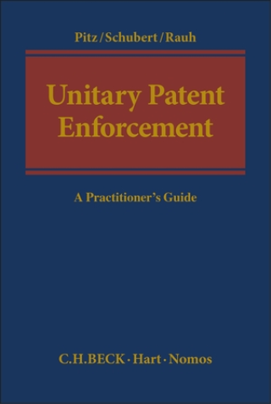
LAW [GB]
Unitary Patent Enforcement
A Practitioner’s Guide
Edited by Johannes Pitz, Thure Schubert & Georg Andreas Rauh
  Explores the procedures before the UPC both with respect to substantial aspects of the unitary patent, in particular the scope of protection, as well as the procedural enforceability of the Unitary Patent
  Patent lawyers practising in the EU will benefit from the guide to its proceedings that this book provides
06 February 2025
Hardback £160.00
ISBN: 9781509924035
256 pages

Slide 22
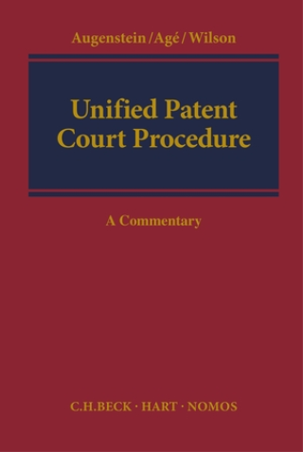
LAW [GB]
Unified Patent Court Procedure
A Commentary
Christof Augenstein, Sabine Agé & Alex Wilson
  This commentary examines the procedure of the Unitary Patent Court.
  Chapters cover: Infringement and Defences; Proceedings and the UPC; Statutes of the UPCC; Financial Provisions; General Provisions; Languages of Proceedings; Proceedings before the Court; Powers of the Court; Appeals; Decisions and Implementation and Operation of Agreement.
  An interesting read for practitioners and academics working in the field of copyright law and civil procedure.
06 February 2025
Hardback £300.00
ISBN: 9781849464932
1000 pages

Slide 23

LAW [GB]
The EU Audiovisual Media Services Directive
Comparative Commentary on the AVMSD and National Implementation
Edited by Mark D Cole & Jenny Metzdorf
  This original commentary sets out, article-by-article, the provisions contained in the Directive before analysing domestic transpositions.
  The book takes a comparative approach by systematically examining the national implementing measures of the future 28 Member States (including Croatia), revealing similarities and differences and analysing their compliance with the Directive.
  A unique reference point for regulatory authorities, media entities, academics, lawyers and political interest groups working in the field of media law.
29 May 2025
Hardback £200.00
ISBN: 9781849467858
1008 pages

Slide 24

LAW [GB]
Global Restructuring
Edited by Ursula Schlegel, Stephan Madaus & David Alisson
This book shall provide a global compilation of above 50 concise introductions to insolvency/ restructuring jurisdictions; complemented by an overview on international procedural and recognition rules.
29 May 2025
Hardback £250.00
ISBN: 9781509931392
1008 pages

Slide 25
LAW [GB]
SEP with FRAND-declaration in Arbitral Proceedings
Edited by Peter Chrocziel, Thomas Kuhnen & Erik Schafer
29 May 2025
Hardback £170.00
ISBN: 9781509931453
256 pages

Slide 26

LAW [GB]
European Merger Control
A Handbook
2nd Edition
Edited by Michael Rosenthal & Stefan Thomas
  Specific and detailed treatment of EU merger control
  Comprehensive and up-to-date overview of recent case law and Commission guidance
  Detailed analysis of economic issues posed by the EUMR
29 May 2025
Hardback £295.00
ISBN: 9781509926152
720 pages

Slide 27

LAW [GB]
European Banking Regulation
Edited by Horst Eidenmüller, Mathias Habersack & Lars Klöhn
  Rigorous examination of the new ‘post crisis’ banking regulatory framework
  Assesses the effectiveness of new framework
29 May 2025
Hardback £100.00
ISBN: 9781509923953
304 pages

Slide 28
LAW [GB]
The Evolution of the EU Treaties
From the Treaties of Rome to the Conference on the Future of Europe
Klemens H Fischer
  Explores how the EU Treaties evolved
  Comprehensible explanation of the development of EU policy areas from the Treaty of Rome in the 1950s to the Treaty of Lisbon in 2009, which led to an "ever closer union" and ultimately to Brexit
05 September 2024
Hardback £120.00
ISBN: 9781509980147
432 pages

Slide 29
LAW [GB]
Private Law and the Data Act
Münster Colloquia on EU Law and the Digital Economy VIII
Edited by Sebastian Lohsse, Reiner Schulze & Dirk Staudenmayer
  Brings welcome clarification to, and expert explanation of, a fast-moving field of consumer law
  Contributions are based on one of the first specialist events on this topic, which brought together representatives from legal science, legal practice, business and politics
31 October 2024
Hardback £65.00
ISBN: 9781509985166
256 pages

Slide 30
LAW [GB]
The Action to Set Aside under Stock Corporation Law in the Context of Structural Measures
Reform Needed?
Tino Sekera-Terplan
This book explores actions to set aside under stock corporation law by studying the legal problems connected with the right to challenge such measures, including by looking into practical cases. By means of an empirical survey, the author subsequently analyses how the action to set structural measures aside has developed since the last legislative reform. Furthermore, the author casts a glance at legal protection against structural measures in Slovakia, Austria, Italy, Spain and the USA, making proposals for the German legislator as to how to modify the shareholder's right to challenge structural measures. This will give much needed clarity to a complex question of corporation law, making it essential reading for practitioner in the field.
28 November 2024
Hardback £120.00
ISBN: 9781509935239
304 pages

Slide 31

LAW [GB]
European Energy Law
A Handbook
Edited by Daniela Winkler, Max Baumgart & Thomas Ackermann
  Provides a prerequisite for successful work in the energy industry, politics, administration and associations
28 November 2024
Hardback £225.00
ISBN: 9781509964109
512 pages

Slide 32

LAW [GB]
New Digital Services Act
A Practitioner's Guide
Edited by Torsten Kraul
  Provides clarity on the New Digital Services act from a renowned expert in the field
  Clarifies in a comprehensible manner which providers are specifically affected under which conditions
26 December 2024
Hardback £140.00
ISBN: 9781509969982
240 pages

Slide 33

LAW [GB]
Dispute Resolution and Conflict of Laws
Edited by Thomas Pfeiffer & Jan von Hein
As European conflict of laws principles, the Rome Regulations have largely replaced national regulations and are directly applicable in every EU Member State. Accompanied by the increasing number of cross-border issues in Europe, it is indispensable for national legal consultation to be acquainted with the relevant conflict of laws rules. The new European conflict of laws principles also have a major effect on classical core areas of civil law, including contractual law, criminal law and law of obligation. The new commentary analyses article-by-article all relevant European regulations:
26 December 2024
Hardback £295.00
ISBN: 9781509924158
1008 pages

Slide 34
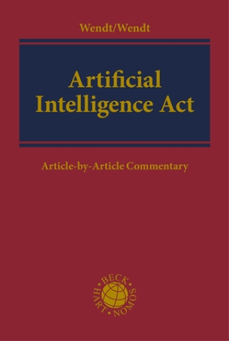
LAW [GB]
Artificial Intelligence Act
Article-by-Article Commentary
Edited by Domenik Henning Wendt & Janine Wendt
  Complete and accessible commentary on the EU Artificial Intelligence Act
06 February 2025
Hardback £225.00
ISBN: 9781509964123
704 pages

Slide 35
Law about Germany

Slide 36

LAW [GB]
The Rule of Law in Context
The Rule of Law in Germany
Bringing the Rechtsstaat into the 21st Century
Dana Burchardt & Hannah Birkenkötter
  Provides a comprehensive insight into rule of law experiences and discourses in Germany.
  Combines historical, doctrinal and socio-legal perspectives
  Highlights digitalisation as a challenge for the future of the rule of law in Germany and beyond.
09 January 2025
Hardback £85.00
ISBN: 9781509969296
216 pages

Slide 37

LAW [GB]
Studies in Private International Law
The Application of Foreign Law in the British and German Courts
Alexander DJ Critchley
  Expertly tracks the development and application of a central tenet of private international law
  Offers a comparative analysis, drawing on the law in England and Wales, Scotland, and Germany
27 June 2024
Paperback £41.99
ISBN: 9781509959624
280 pages

